Slide 1

Our Lady’s Catholic High School
Achieving Success Together
Notes:
Good Evening Everyone.
I want to begin by giving you a very important date for your diaries…….

Slide 2
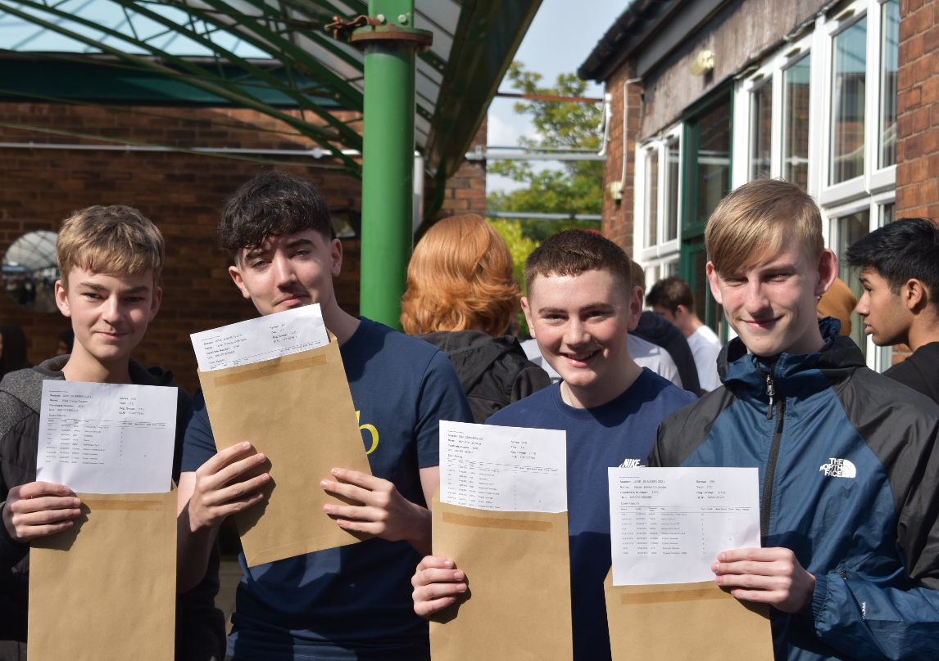
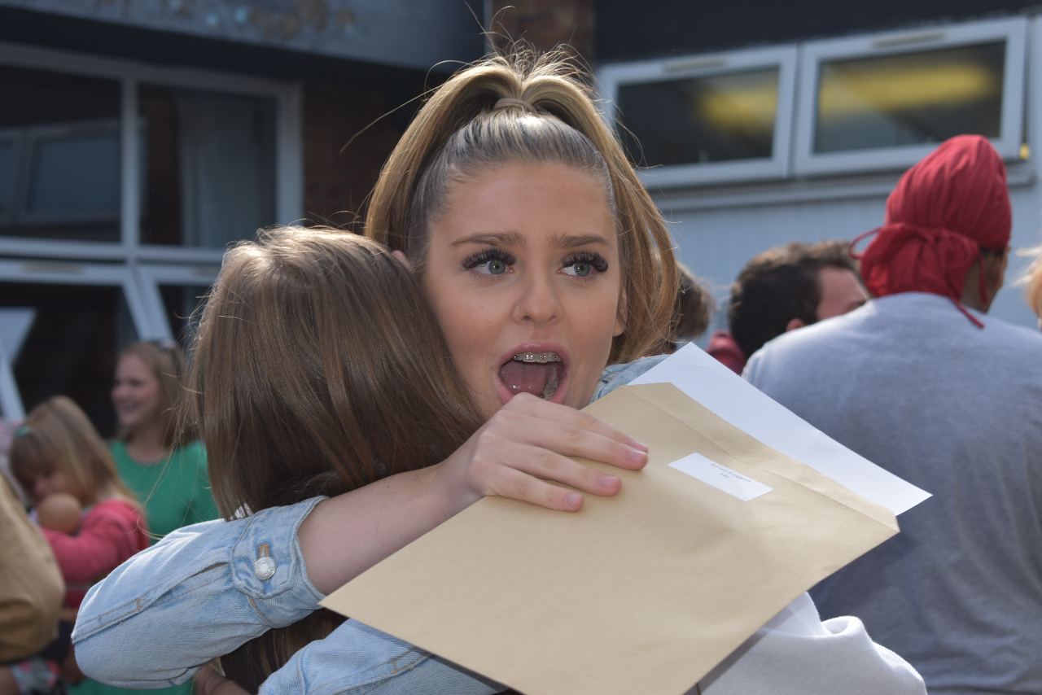
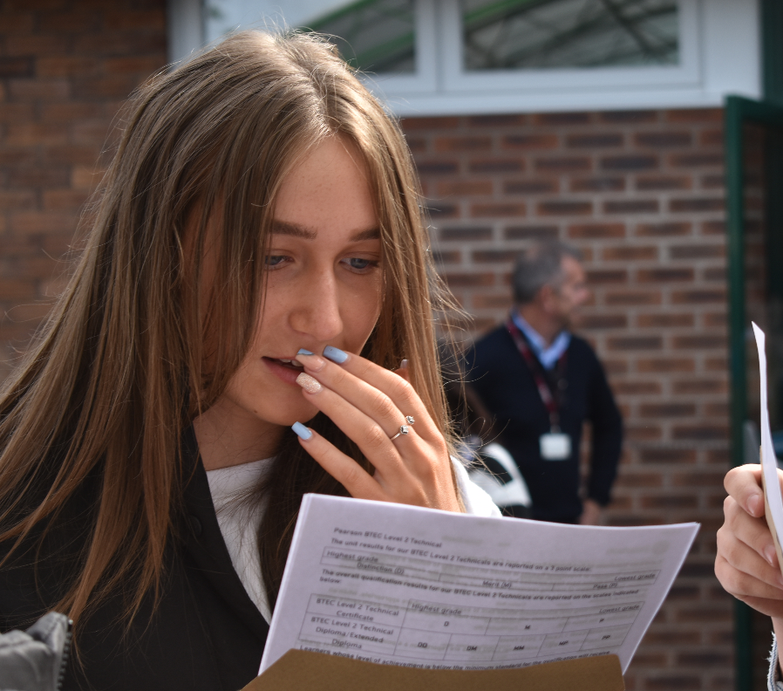
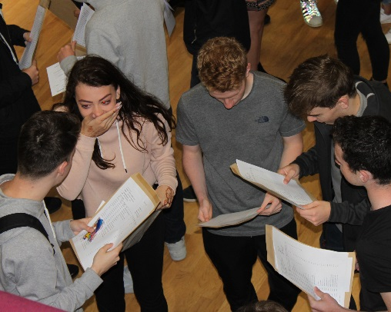
Thursday 26 August 2027
GCSE Results Day
Notes:
Here at Our Lady’s our pupils have an outstanding record of success at GCSEs but that just does not happen by accident – it is the culmination of 5 years of hard work! But it is not just at school where that takes place. We’ve been helping children achieve their full potential for 30 years and we know that children achieve when home and school work together.
We want to help you to work closely with school and your child over the next five years and we want to start this process by ensuring that you are really familiar with the various systems that we have developed to help your child achieve success at Our Lady’s.

Slide 3
Our Lady’s Catholic High School
Mr Power
Assistant Headteacher

Slide 4
Helping pupils to succeed
Grouping
Targets
Reports
Progress Scores
Notes:
In this powerpoint we will explain four areas where we can work together to help your child succeed.
How we group pupils by ability
How we set targets for pupils
How we report to you as parents
And how we use what we call progress scores to track progress and reward success and what these progress scores mean.

Slide 5
Grouping
Notes:
Why do we set pupils in ability groups? Put simply we want to ensure that children achieve their potential and so we want to ensure that the curriculum is matched to each pupils’ capability. We have outstanding teachers who work hard to ensure that their lessons are pitched at the right level for the pupils who are in front of them. The teachers want to ensure that each child is CHALLENGED in lessons as by challenging them we’ll help them make outstanding progress and ultimately in five years achieve a great set of results.
Going forward pupils will be placed in ability groups from Monday 31 October after half-term. Pupils will be given their new timetables on the Friday before we break up and be given a letter which will indicate their new classes.

Slide 6
7O
Art
Drama
English
French
Geography
History
Computer Science
Mathematics
Music
RE
Science
7U
7R
7L
7A
7D
Notes:
How will this change what happens currently?
At present most pupils are taught in their form groups for the following subjects which are listed.
TECHNOLOGY pupils are currently in mixed ability groups that are slightly different to form groups and PE is grouped by ability which will be sorted by the PE Department.

Slide 7
English
Computer Science
French
Geography
History
RE
Science
Mathematics
PE
C2
M
C1
T2
B2
T1
B1
Notes:
From Monday 31 October pupils will be grouped by ability for their subjects.
They are arranged into four separate bands which are parallel in ability.
So there will be B1 & B2, C1 & C2, T1 & T2 and finally M group who are the pupils who will need the most support in lessons.
There will be common setting for the following subjects.
Setting for maths can be different from other subjects – but the grouping structure is the same.
PE will set according to ability and may be different to the other subjects.

Slide 8
No change
Art
Design and Technology
Drama
Music
Notes:
There will be changes in some subjects but groups for art DT Drama Music and will NOT change.
This helps pupils to remain settled.

Slide 9
How are pupils allocated
to ability groups?
Notes:
We use all of the available data for each child that we have and we review that data. The key data we use is the CAT tests that pupils took recently, along with this we have the NGRT and NGST tests and we also use KS2 Test results which the primary schools have sent to us. Finally, and most importantly, we use our teachers recommendations which have been made on the basis of standardised tests or tasks which your child will have completed in class.
When all of the data is put together it looks like this ….

Slide 10
118 | 124 | 124 | 7 | 8 | 8 | 122 | 39 | 5 | 46 | 5 | 85 | 5 | 95 | 5 | 72 | 5 | 5.4 | 5.7 | 5.5 | 5.7 | 5.5 | 5b | 5a | 5b | 5a | 5b | 1 | 1 | 1 | 1 | 1 | 3 | 1 | 1 | 1 | 1 | 1 | 1 | 1 | 1 | 1 | 1 | 1 | 1.29 | 1.13 | 1 | 1E | 1E | b
122 | 125 | 118 | 8 | 8 | 7 | 122 | 31 | 5 | 38 | 5 | 69 | 5 | 87 | 5 | 65 | 5 | 5 | 5.1 | 5 | 5.4 | 5.1 | 5c | 5c | 5c | 5b | 5c | 1 | 4 | 3 | 4 | 7 | 4 | 3 | 1 | 1 | 1 | 1 | 3 | 1 | 2 | 2 | 3 | 1.67 | 3.71 | 2.56 | 1.33 | 1E | 1E | b
120 | 122 | 122 | 8 | 8 | 8 | 121 | 37 | 5 | 40 | 5 | 77 | 5 | 97 | 5 | 75 | 5 | 5.3 | 5.2 | 5.3 | 5.8 | 5.7 | 5b | 5c | 5b | 5a | 5a | 1 | 3 | 4 | 4 | 1 | 2 | 1 | 1 | 1 | 1 | 1 | 1 | 1 | 1 | 1 | 1 | 1 | 2.29 | 1.56 | 1 | 1E | 1E | b
114 | 122 | 126 | 7 | 8 | 8 | 121 | 38 | 5 | 38 | 5 | 76 | 5 | 85 | 5 | 73 | 5 | 5.3 | 5.1 | 5.2 | 5.3 | 5.5 | 5b | 5c | 5c | 5b | 5b | 2 | 1 | 1 | 1 | 1 | 1 | 1 | 1 | 1 | 1 | 1 | 1 | 1 | 1 | 2 | 1 | 1.11 | 1.14 | 1.13 | 1.67 | 1E | 1E | b
124 | 117 | 120 | 8 | 7 | 8 | 120 | 30 | 4 | 31 | 4 | 61 | 4 | 87 | 5 | 79 | 5 | 4.9 | 4.5 | 4.7 | 5.4 | 5.9 | 4a | 4b | 4a | 5b | 5a | 1 | 3 | 3 | 5 | 2 | 4 | 3 | 1 | 1 | 1 | 1 | 3 | 3 | 3 | 2 | 1 | 1.78 | 3 | 2.31 | 1.33 | 1E | 1E | b
126 | 122 | 112 | 8 | 8 | 7 | 120 | 40 | 5 | 38 | 5 | 78 | 5 | 84 | 5 | 67 | 5 | 5.4 | 5.1 | 5.3 | 5.3 | 5.2 | 5b | 5c | 5b | 5b | 5c | 2 | 1 | 2 | 2 | 1 | 2 | 1 | 1 | 1 | 2 | 1 | 1 | 1 | 1 | 2 | 2 | 1.33 | 1.57 | 1.44 | 1.67 | 1E | 1E | b
124 | 127 | 108 | 8 | 9 | 6 | 120 | 38 | 5 | 33 | 4 | 71 | 5 | 85 | 5 | 70 | 5 | 5.3 | 4.7 | 5.1 | 5.3 | 5.4 | 5b | 4a | 5c | 5b | 5b | 2 | 1 | 1 | 2 | 1 | 3 | 2 | 1 | 1 | 2 | 1 | 1 | 2 | 2 | 2 | 2 | 1.56 | 1.71 | 1.63 | 1.67 | 1E | 1E | b
114 | 120 | 124 | 7 | 8 | 8 | 119 | 41 | 5 | 39 | 5 | 80 | 5 | 89 | 5 | 72 | 5 | 5.5 | 5.2 | 5.3 | 5.5 | 5.5 | 5b | 5c | 5b | 5b | 5b | 2 | 1 | 1 | 1 | 1 | 2 | 1 | 1 | 1 | 1 | 1 | 1 | 1 | 1 | 1 | 1 | 1 | 1.29 | 1.13 | 1.33 | 1E | 1E | b
110 | 118 | 130 | 6 | 7 | 9 | 119 | 33 | 5 | 36 | 5 | 69 | 5 | 93 | 5 | 76 | 5 | 5.1 | 5 | 5 | 5.6 | 5.7 | 5c | 5c | 5c | 5b | 5a | 1 | 1 | 3 | 2 | 1 | 3 | 3 | 2 | 1 | 1 | 1 | 2 | 2 | 2 | 1 | 1 | 1.44 | 2 | 1.69 | 1 | 1E | 1E | b
126 | 124 | 107 | 8 | 8 | 6 | 119 | 33 | 5 | 32 | 4 | 65 | 4 | 95 | 5 | 72 | 5 | 5.1 | 4.6 | 4.9 | 5.7 | 5.5 | 5c | 4b | 4a | 5a | 5b | 1 | 3 | 3 | 4 | 2 | 4 | 3 | 1 | 1 | 2 | 1 | 2 | 3 | 3 | 1 | 1 | 1.67 | 2.86 | 2.19 | 1 | 1E | 1E | b
119 | 123 | 113 | 8 | 8 | 7 | 118 | 42 | 5 | 35 | 4 | 77 | 5 | 94 | 5 | 73 | 5 | 5.5 | 4.9 | 5.3 | 5.7 | 5.5 | 5b | 4a | 5b | 5a | 5b | 1 | 1 | 1 | 3 | 1 | 3 | 2 | 1 | 1 | 2 | 1 | 1 | 2 | 1 | 1 | 1 | 1.22 | 1.71 | 1.44 | 1 | 1E | 1E | b
127 | 115 | 111 | 9 | 7 | 6 | 118 | 36 | 5 | 43 | 5 | 79 | 5 | 97 | 5 | 68 | 5 | 5.2 | 5.4 | 5.3 | 5.8 | 5.2 | 5c | 5b | 5b | 5a | 5c | 1 | 2 | 1 | 2 | 1 | 2 | 1 | 1 | 1 | 2 | 1 | 2 | 1 | 1 | 1 | 2 | 1.33 | 1.43 | 1.38 | 1 | 1E | 1E | b
109 | 126 | 115 | 6 | 8 | 7 | 117 | 35 | 5 | 41 | 5 | 76 | 5 | 93 | 5 | 68 | 5 | 5.2 | 5.3 | 5.2 | 5.6 | 5.2 | 5c | 5b | 5c | 5b | 5c | 1 | 1 | 2 | 2 | 1 | 3 | 1 | 2 | 1 | 1 | 1 | 2 | 1 | 1 | 1 | 2 | 1.33 | 1.57 | 1.44 | 1 | 1E | 1E | b
112 | 114 | 123 | 7 | 7 | 8 | 116 | 31 | 5 | 31 | 4 | 62 | 4 | 87 | 5 | 66 | 5 | 5 | 4.5 | 4.8 | 5.4 | 5.1 | 5c | 4b | 4a | 5b | 5c | 1 | 3 | 1 | 3 | 2 | 2 | 3 | 2 | 2 | 1 | 1 | 3 | 3 | 3 | 2 | 2 | 2.11 | 2.14 | 2.13 | 1.67 | 1E | 1E | b
123 | 111 | 115 | 8 | 6 | 7 | 116 | 37 | 5 | 40 | 5 | 77 | 5 | 88 | 5 | 68 | 5 | 5.3 | 5.2 | 5.3 | 5.4 | 5.2 | 5b | 5c | 5b | 5b | 5c | 1 | 2 | 1 | 2 | 1 | 1 | 2 | 1 | 2 | 1 | 1 | 1 | 1 | 1 | 1 | 2 | 1.22 | 1.43 | 1.31 | 1.33 | 1E | 1E | b
102 | 114 | 133 | 5 | 7 | 9 | 116 | 29 | 4 | 24 | 3 | 53 | 4 | 91 | 5 | 74 | 5 | 4.9 | 3.9 | 4.4 | 5.6 | 5.6 | 4a | 3a | 4b | 5b | 5b | 1 | 3 | 3 | 4 | 3 | 2 | 5 | 3 | 2 | 1 | 1 | 3 | 5 | 4 | 1 | 1 | 2.33 | 3 | 2.63 | 1.33 | 1A | 1E | b
112 | 125 | 111 | 7 | 8 | 6 | 116 | 37 | 5 | 30 | 4 | 67 | 5 | 84 | 5 | 73 | 5 | 5.3 | 4.4 | 5 | 5.3 | 5.5 | 5b | 4b | 5c | 5b | 5b | 1 | 1 | 2 | 4 | 2 | 4 | 1 | 2 | 1 | 2 | 1 | 1 | 3 | 2 | 2 | 1 | 1.67 | 2.14 | 1.88 | 1.33 | 1E | 1E | b
114 | 116 | 117 | 7 | 7 | 7 | 116 | 35 | 5 | 37 | 5 | 72 | 5 | 93 | 5 | 71 | 5 | 5.2 | 5 | 5.1 | 5.6 | 5.4 | 5c | 5c | 5c | 5b | 5b | 1 | 1 | 2 | 1 | 1 | 3 | 2 | 2 | 1 | 1 | 1 | 2 | 1 | 2 | 1 | 1 | 1.33 | 1.57 | 1.44 | 1 | 1E | 1E | b
111 | 119 | 116 | 6 | 8 | 7 | 115 | 40 | 5 | 32 | 4 | 72 | 5 | 91 | 5 | 73 | 5 | 5.4 | 4.6 | 5.1 | 5.6 | 5.5 | 5b | 4b | 5c | 5b | 5b | 1 | 2 | 1 | 2 | 1 | 1 | 2 | 2 | 1 | 1 | 1 | 1 | 3 | 2 | 1 | 1 | 1.44 | 1.43 | 1.44 | 1 | 1E | 1E | b
118 | 114 | 112 | 7 | 7 | 7 | 115 | 31 | 5 | 34 | 4 | 65 | 4 | 92 | 5 | 74 | 5 | 5 | 4.8 | 4.9 | 5.6 | 5.6 | 5c | 4a | 4a | 5b | 5b | 1 | 2 | 2 | 2 | 2 | 3 | 2 | 1 | 2 | 2 | 1 | 3 | 2 | 2 | 1 | 1 | 1.67 | 2 | 1.81 | 1.33 | 1A | 1E | b
107 | 115 | 118 | 6 | 7 | 7 | 113 | 34 | 5 | 30 | 4 | 64 | 4 | 91 | 5 | 72 | 5 | 5.1 | 4.4 | 4.9 | 5.6 | 5.5 | 5c | 4b | 4a | 5b | 5b | 1 | 3 | 3 | 4 | 2 | 2 | 4 | 2 | 2 | 1 | 2 | 2 | 3 | 3 | 1 | 1 | 1.89 | 2.71 | 2.25 | 1.33 | 1A | 1E | b
119 | 111 | 108 | 8 | 6 | 6 | 113 | 38 | 5 | 43 | 5 | 81 | 5 | 92 | 5 | 76 | 5 | 5.3 | 5.4 | 5.4 | 5.6 | 5.7 | 5b | 5b | 5b | 5b | 5a | 1 | 1 | 1 | 1 | 1 | 1 | 1 | 1 | 2 | 2 | 2 | 1 | 1 | 1 | 1 | 1 | 1.33 | 1 | 1.19 | 1.33 | 1E | 1E | b
100 | 122 | 114 | 5 | 8 | 7 | 112 | 31 | 5 | 30 | 4 | 61 | 4 | 83 | 5 | 62 | 4 | 5 | 4.4 | 4.7 | 5.2 | 4.9 | 5c | 4b | 4a | 5c | 4a | 1 | 3 | 3 | 4 | 2 | 5 | 4 | 4 | 1 | 1 | 2 | 3 | 3 | 3 | 2 | 3 | 2.44 | 3.14 | 2.75 | 1.33 | 1A | 1E | b
113 | 115 | 107 | 7 | 7 | 6 | 112 | 40 | 5 | 34 | 4 | 74 | 5 | 91 | 5 | 63 | 5 | 5.4 | 4.8 | 5.2 | 5.6 | 5 | 5b | 4a | 5c | 5b | 5c | 1 | 2 | 4 | 2 | 1 | 1 | 1 | 2 | 2 | 2 | 2 | 1 | 2 | 1 | 1 | 3 | 1.78 | 1.71 | 1.75 | 1.33 | 1A | 1E | b
115 | 120 | 100 | 7 | 8 | 5 | 112 | 38 | 5 | 36 | 5 | 74 | 5 | 86 | 5 | 67 | 5 | 5.3 | 5 | 5.2 | 5.3 | 5.2 | 5b | 5c | 5c | 5b | 5c | 2 | 2 | 2 | 3 | 1 | 3 | 1 | 1 | 1 | 3 | 2 | 1 | 2 | 1 | 2 | 2 | 1.67 | 2 | 1.81 | 1.67 | 1A | 1E | b
103 | 115 | 117 | 5 | 7 | 7 | 112 | 38 | 5 | 30 | 4 | 68 | 5 | 90 | 5 | 70 | 5 | 5.3 | 4.4 | 5 | 5.5 | 5.4 | 5b | 4b | 5c | 5b | 5b | 1 | 3 | 1 | 4 | 1 | 4 | 3 | 3 | 2 | 1 | 2 | 1 | 3 | 2 | 1 | 2 | 1.89 | 2.43 | 2.13 | 1.33 | 1A | 1E | b
112 | 122 | 99 | 7 | 8 | 5 | 111 | 39 | 5 | 33 | 4 | 72 | 5 | 88 | 5 | 63 | 5 | 5.4 | 4.7 | 5.1 | 5.4 | 5 | 5b | 4a | 5c | 5b | 5c | 2 | 2 | 1 | 2 | 1 | 3 | 1 | 2 | 1 | 3 | 2 | 1 | 2 | 2 | 1 | 3 | 1.89 | 1.71 | 1.81 | 1.33 | 1A | 1E | b
109 | 121 | 103 | 6 | 8 | 5 | 111 | 40 | 5 | 32 | 4 | 72 | 5 | 91 | 5 | 70 | 5 | 5.4 | 4.6 | 5.1 | 5.6 | 5.4 | 5b | 4b | 5c | 5b | 5b | 1 | 1 | 2 | 2 | 1 | 3 | 1 | 2 | 1 | 3 | 2 | 1 | 3 | 2 | 1 | 2 | 1.89 | 1.57 | 1.75 | 1 | 1A | 1E | b
101 | 112 | 119 | 5 | 7 | 8 | 111 | 22 | 4 | 24 | 3 | 46 | 4 | 86 | 5 | 66 | 5 | 4.2 | 3.9 | 4 | 5.3 | 5.1 | 4c | 3a | 4c | 5b | 5c | 1 | 5 | 2 | 5 | 3 | 2 | 5 | 3 | 2 | 1 | 2 | 5 | 5 | 5 | 2 | 2 | 3 | 3.29 | 3.13 | 1.67 | 1B | 1E | b
98 | 117 | 114 | 5 | 7 | 7 | 110 | 36 | 5 | 21 | 3 | 57 | 4 | 91 | 5 | 70 | 5 | 5.2 | 3.7 | 4.5 | 5.6 | 5.4 | 5c | 3a | 4b | 5b | 5b | 1 | 2 | 3 | 2 | 2 | 3 | 3 | 4 | 1 | 2 | 2 | 2 | 5 | 4 | 1 | 2 | 2.56 | 2.29 | 2.44 | 1 | 1B | 1E | b
112 | 108 | 107 | 7 | 6 | 6 | 109 | 38 | 5 | 37 | 5 | 75 | 5 | 92 | 5 | 74 | 5 | 5.3 | 5 | 5.2 | 5.6 | 5.6 | 5b | 5c | 5c | 5b | 5b | 1 | 1 | 1 | 1 | 1 | 2 | 2 | 2 | 3 | 2 | 2 | 1 | 1 | 1 | 1 | 1 | 1.56 | 1.29 | 1.44 | 1.67 | 1E | 1E | b
141 | 110 | 129 | 9 | 6 | 9 | 127 | 39 | 5 | 39 | 5 | 78 | 5 | 88 | 5 | 78 | 5 | 5.4 | 5.2 | 5.3 | 5.4 | 5.8 | 5b | 5c | 5b | 5b | 5a | 2 | 1 | 1 | 1 | 1 | 4 | 2 | 1 | 2 | 1 | 1 | 1 | 1 | 1 | 1 | 1 | 1.11 | 1.71 | 1.38 | 1.67 | 1E | 1A | b
115 | 111 | 141 | 7 | 6 | 9 | 122 | 26 | 4 | 36 | 5 | 62 | 4 | 84 | 5 | 74 | 5 | 4.6 | 5 | 4.8 | 5.3 | 5.6 | 4b | 5c | 4a | 5b | 5b | 1 | 1 | 1 | 2 | 2 | 5 | 2 | 1 | 2 | 1 | 1 | 5 | 2 | 3 | 2 | 1 | 2 | 2 | 2 | 1.67 | 1E | 1A | b
114 | 117 | 125 | 7 | 7 | 8 | 119 | 26 | 4 | 27 | 4 | 53 | 4 | 92 | 5 | 72 | 5 | 4.6 | 4.1 | 4.4 | 5.6 | 5.5 | 4b | 4c | 4b | 5b | 5b | 2 | 2 | 1 | 2 | 2 | 4 | 3 | 1 | 1 | 1 | 1 | 5 | 4 | 4 | 1 | 1 | 2.11 | 2.29 | 2.19 | 1.33 | 1E | 1A | b
117 | 120 | 118 | 7 | 8 | 7 | 118 | 37 | 5 | 33 | 4 | 70 | 5 | 85 | 5 | 64 | 5 | 5.3 | 4.7 | 5 | 5.3 | 5 | 5b | 4a | 5c | 5b | 5c | 3 | 2 | 2 | 2 | 1 | 2 | 2 | 1 | 1 | 1 | 1 | 1 | 2 | 2 | 2 | 3 | 1.56 | 2 | 1.75 | 2 | 1E | 1A | b
117 | 105 | 128 | 7 | 6 | 9 | 117 | 36 | 5 | 36 | 5 | 72 | 5 | 89 | 5 | 74 | 5 | 5.2 | 5 | 5.1 | 5.5 | 5.6 | 5c | 5c | 5c | 5b | 5b | 2 | 2 | 1 | 2 | 1 | 1 | 1 | 1 | 3 | 1 | 1 | 2 | 2 | 2 | 1 | 1 | 1.56 | 1.43 | 1.5 | 2 | 1E | 1A | b
119 | 110 | 115 | 8 | 6 | 7 | 115 | 40 | 5 | 47 | 5 | 87 | 5 | 87 | 5 | 73 | 5 | 5.4 | 5.7 | 5.6 | 5.4 | 5.5 | 5b | 5a | 5b | 5b | 5b | 2 | 1 | 1 | 1 | 1 | 3 | 1 | 1 | 2 | 1 | 1 | 1 | 1 | 1 | 2 | 1 | 1.22 | 1.43 | 1.31 | 2 | 1E | 1A | b
123 | 121 | 100 | 8 | 8 | 5 | 115 | 32 | 5 | 40 | 5 | 72 | 5 | 70 | 4 | 59 | 4 | 5 | 5.2 | 5.1 | 4.7 | 4.8 | 5c | 5c | 5c | 4a | 4a | 3 | 1 | 1 | 3 | 3 | 3 | 1 | 1 | 1 | 3 | 1 | 3 | 1 | 2 | 3 | 4 | 2.11 | 2.14 | 2.13 | 2.33 | 1E | 1A | b
112 | 108 | 123 | 7 | 6 | 8 | 114 | 40 | 5 | 35 | 4 | 75 | 5 | 91 | 5 | 77 | 5 | 5.4 | 4.9 | 5.2 | 5.6 | 5.8 | 5b | 4a | 5c | 5b | 5a | 1 | 1 | 1 | 1 | 1 | 2 | 1 | 2 | 3 | 1 | 1 | 1 | 2 | 1 | 1 | 1 | 1.44 | 1.14 | 1.31 | 1.67 | 1E | 1A | b
112 | 119 | 110 | 7 | 8 | 6 | 114 | 35 | 5 | 34 | 4 | 69 | 5 | 80 | 5 | 68 | 5 | 5.2 | 4.8 | 5 | 5.1 | 5.2 | 5c | 4a | 5c | 5c | 5c | 3 | 3 | 2 | 3 | 2 | 3 | 1 | 2 | 1 | 2 | 1 | 2 | 2 | 2 | 3 | 2 | 1.89 | 2.43 | 2.13 | 2.33 | 1A | 1A | b
109 | 112 | 120 | 6 | 7 | 8 | 114 | 30 | 4 | 26 | 4 | 56 | 4 | 87 | 5 | 74 | 5 | 4.9 | 4 | 4.5 | 5.4 | 5.6 | 4a | 4c | 4b | 5b | 5b | 2 | 2 | 4 | 3 | 2 | 5 | 4 | 2 | 2 | 1 | 1 | 3 | 4 | 4 | 2 | 1 | 2.22 | 3.14 | 2.63 | 2 | 1A | 1A | b
117 | 108 | 115 | 7 | 6 | 7 | 113 | 31 | 5 | 27 | 4 | 58 | 4 | 91 | 5 | 70 | 5 | 5 | 4.1 | 4.6 | 5.6 | 5.4 | 5c | 4c | 4b | 5b | 5b | 2 | 4 | 3 | 4 | 2 | 2 | 3 | 1 | 3 | 1 | 2 | 3 | 4 | 4 | 1 | 2 | 2.33 | 2.86 | 2.56 | 2 | 1A | 1A | b
120 | 106 | 110 | 8 | 6 | 6 | 112 | 39 | 5 | 44 | 5 | 83 | 5 | 93 | 5 | 78 | 5 | 5.4 | 5.5 | 5.4 | 5.6 | 5.8 | 5b | 5b | 5b | 5b | 5a | 1 | 1 | 1 | 2 | 1 | 2 | 1 | 1 | 3 | 2 | 2 | 1 | 1 | 1 | 1 | 1 | 1.44 | 1.29 | 1.38 | 1.67 | 1E | 1A | b
114 | 108 | 111 | 7 | 6 | 6 | 111 | 37 | 5 | 37 | 5 | 74 | 5 | 93 | 5 | 70 | 5 | 5.3 | 5 | 5.2 | 5.6 | 5.4 | 5b | 5c | 5c | 5b | 5b | 1 | 1 | 1 | 3 | 1 | 4 | 1 | 1 | 3 | 2 | 2 | 1 | 1 | 1 | 1 | 2 | 1.56 | 1.71 | 1.63 | 1.67 | 1E | 1A | b
104 | 114 | 113 | 6 | 7 | 7 | 110 | 36 | 5 | 36 | 5 | 72 | 5 | 83 | 5 | 70 | 5 | 5.2 | 5 | 5.1 | 5.2 | 5.4 | 5c | 5c | 5c | 5c | 5b | 2 | 1 | 3 | 1 | 2 | 3 | 1 | 3 | 2 | 2 | 2 | 2 | 2 | 2 | 2 | 2 | 2.11 | 1.86 | 2 | 2 | 1A | 1A | b
108 | 111 | 109 | 6 | 6 | 6 | 109 | 37 | 5 | 37 | 5 | 74 | 5 | 88 | 5 | 68 | 5 | 5.3 | 5 | 5.2 | 5.4 | 5.2 | 5b | 5c | 5c | 5b | 5c | 2 | 1 | 2 | 1 | 1 | 2 | 2 | 2 | 2 | 2 | 2 | 1 | 1 | 1 | 1 | 2 | 1.56 | 1.57 | 1.56 | 1.67 | 1A | 1A | b
106 | 115 | 107 | 6 | 7 | 6 | 109 | 34 | 5 | 35 | 4 | 69 | 5 | 84 | 5 | 58 | 4 | 5.1 | 4.9 | 5 | 5.3 | 4.8 | 5c | 4a | 5c | 5b | 4a | 3 | 3 | 2 | 4 | 2 | 4 | 2 | 3 | 2 | 2 | 2 | 2 | 2 | 2 | 2 | 4 | 2.33 | 2.86 | 2.56 | 2.33 | 1B | 1A | b
104 | 122 | 99 | 6 | 8 | 5 | 108 | 33 | 5 | 35 | 4 | 68 | 5 | 81 | 5 | 67 | 5 | 5.1 | 4.9 | 5 | 5.1 | 5.2 | 5c | 4a | 5c | 5c | 5c | 3 | 2 | 1 | 2 | 2 | 2 | 1 | 3 | 1 | 3 | 2 | 2 | 2 | 2 | 3 | 2 | 2.22 | 1.86 | 2.06 | 2.33 | 1A | 1A | b
109 | 100 | 115 | 6 | 5 | 7 | 108 | 33 | 5 | 15 | 3 | 48 | 4 | 85 | 5 | 71 | 5 | 5.1 | 3.3 | 4.1 | 5.3 | 5.4 | 5c | 3b | 4c | 5b | 5b | 2 | 1 | 2 | 6 | 3 | 4 | 5 | 2 | 4 | 1 | 2 | 3 | 6 | 5 | 2 | 1 | 2.89 | 3.29 | 3.06 | 2.67 | 1B | 1A | b
107 | 113 | 100 | 6 | 7 | 5 | 107 | 37 | 5 | 33 | 4 | 70 | 5 | 86 | 5 | 63 | 5 | 5.3 | 4.7 | 5 | 5.3 | 5 | 5b | 4a | 5c | 5b | 5c | 2 | 1 | 1 | 1 | 1 | 2 | 1 | 3 | 2 | 3 | 2 | 1 | 2 | 2 | 2 | 3 | 2.22 | 1.29 | 1.81 | 2 | 1A | 1A | b
108 | 105 | 104 | 6 | 6 | 6 | 106 | 34 | 5 | 27 | 4 | 61 | 4 | 84 | 5 | 69 | 5 | 5.1 | 4.1 | 4.7 | 5.3 | 5.3 | 5c | 4c | 4a | 5b | 5b | 1 | 1 | 1 | 1 | 2 | 2 | 2 | 2 | 3 | 3 | 2 | 2 | 4 | 3 | 2 | 2 | 2.56 | 1.43 | 2.06 | 2 | 1A | 1A | b
Notes:
I want to assure you that this is a process we do not take lightly and the staff work very hard to ensure we place your child in the right group for them.
We review the setting regularly and it’s important to know that no pupil has a place in a group for their five years. If it is right for them to move – we’ll move them.

Slide 11
Targets and Grades
3.1 / 3.5 / 3.9
Notes:
At KS3 we will give the pupils a Key Stage 3 Target grade and it will be a number followed by another number.
The first number is the Key Stage 3 grade we want the pupils to strive to achieve. The second number indicates where they are on this grade
.1 – just achieved it
.5 secure in this grade
.9 close to exceeding it
What it means to achieve these KS3 grades will be explained by the class teacher as what is expected in an Art Lesson is different to and English and what a strong grade looks like in Geography is different than Maths.
The important thing to know is that we will set the pupils challenging targets each year for them to aspire to and we will monitor the progress they are making to those targets and keep parents informed about the progress.
It is also important that to understand that we don’t set targets by applying a formula - we look at each individual child and base our target on them.
The targets are set during the second half of this term and will go home shortly afterwards.
We review the pupils targets regularly and EVERY Year we will set the pupils a new target based on the progress they have made.

Slide 12
Assessment and
Reporting

Slide 13
Interim Progress Reports
Parents’ evening (Thursday 23rd March 2023)
End of Year Report
Notes:
At the end of autumn and the end of the spring term parents receive an interim progress report which gives numerical information about the pupils.
We will also hold a Parents Evening on Thursday 23 March when the pupils will have made appointments with their subject teachers and parents will have an opportunity to discuss their child’s progress with each teacher. We encourage parents to have the pupils with them on these evenings as it is important that they are aware of what THEY need to do to continue to make progress. We hold these virtually as parents have indicated that they like the flexibility to book appointments when it suits them, plus there are no huge queues waiting for one teacher. If at the end of parents evening parents feel that they need to speak further to any teacher then they are always available to talk to, either on the phone or via email.
Then at the end of the year parents will receive a Full progress report about the pupils – this will be a written report from each subject area as well as a report from the Form Tutor.

Slide 14
Learning and Progress
Behaviour
Completion of homework
Notes:
For both the Interim and the End of Year Reports the pupils will be given 3 grades - one for Learning and Progress, one for Behaviour and one for completion of homework.
The Interim Reports will contain just these grades whilst the end of year report will also have comments from the teachers.

Slide 15
1 Outstanding
2 Good
3 Satisfactory
4 Inadequate
Notes:
The grades we give for learning and progress, behaviour and completion of homework are split into four grades from 1 to 4.
1 = Outstanding, 2= Good, 3= Satisfactory and 4 – Inadequate.
The criteria for each of these grades will go home with the report that parents will receive at the end of this term so parents are clear what each grade means.
But be aware to achieve a grade 1 – Outstanding, a pupil will have to be working at their absolute best, behaving exceptionally well and be fully in engaged in all lessons at all times. For that reason gaining a 1 grade really is an outstanding grading.

Slide 16
HOMEWORK COMPLETION - OUTSTANDING
Completes all homework in full as required. The quality of work produced reflects keenness and commitment to succeed. No homeworks are recorded as missing on PARS
Notes:
From our experience pupils who have homework problems in year 7, become results problems when they reach Year 11.
Put simply HOMEWORK PROBLEMS = RESULTS PROBLEMS
As such, it is absolutely critical that pupils with parental help and support, develop good habits at a very early stage.
Work with the pupils to identify the best way to complete homework – get into a routine, put aside a space for them to do their homework, have all the equipment they’ll need there so they don’t spend 15 mins searching the house for that all important ruler and then another 15 mins searching for a pencil sharpener!
Finally on homework we want to stress to parents that if they are concerned at all that if pupils do not seem to be getting enough homework – please get in touch with Mrs Lin as Learning Manager.

Slide 17
Progress Scores
90% + GOLD
80% + SILVER
70% + BRONZE
Notes:
Finally for each report, all scores are converted into a progress score which will be shown as a percentage.
90% gold 80% silver 70 % bronze Last year virtually all pupils in Year 7 achieved 70% or more
If a pupil’s score is below 70% there will be serious concerns that we will need to address. We would expect that the Learning manager will be in touch and their form tutor will have also identified this and will be working on an Action plan to help the pupil get back on track.
We must emphasise this progress score is not about ability – Every pupil at our school can achieve 1’s for everything – they need to behaving well, complete their homework to a high standard and then make very good progress towards their own personal target.
We hope that your child comes home with an outstanding report at the end of the autumn term. If it isn’t then we will work hard with you to secure an improvement.

Slide 18
Our Lady’s Catholic High School
Achieving Success Together

